Slide 1


Automating Rainfall Data Collection for Tamil Nadu
Efficiency and Automation with Python
Arunprakash Babu

Slide 2
The Problem
Manual data collection for historical rainfall data from a website.
No direct URL generation for date-based queries.
Time-consuming process of inputting dates, saving HTML, and extracting data manually.
Inefficient for large datasets (e.g., years of daily data).
Goals and Objectives
Manual data collection for historical rainfall data from a website.
No direct URL generation for date-based queries.
Time-consuming process of inputting dates, saving HTML, and extracting data manually.
Inefficient for large datasets (e.g., years of daily data).

Slide 3
Tools and Libraries
Solution Overview
Selenium: For browser automation.
BeautifulSoup: For parsing HTML content.
pandas: For data transformation and storage.
Chrome WebDriver: To interface with the browser.
datetime: To manage date ranges programmatically.
User inputs start and end dates.
Selenium simulates manual interaction:
Opens the website.
Selects date-based search options.
Enters dates and submits queries.
BeautifulSoup extracts rainfall data from the results.
pandas structures and processes data into a DataFrame.
Data is saved to a CSV file for analysis.

Slide 4
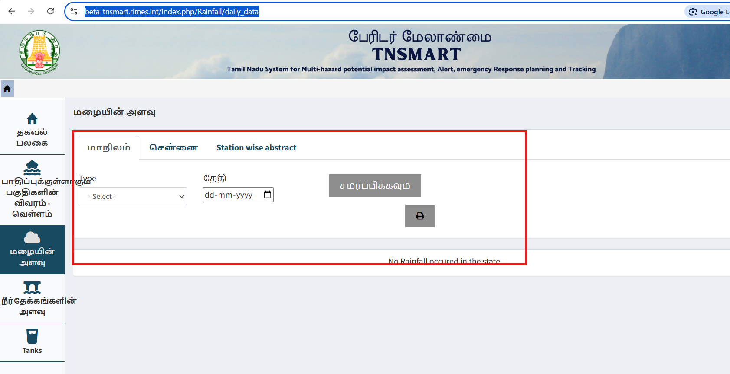
Input and Data Handling
Input and Data Handling
Prompt: "Enter start and end dates in dd-mm-yyyy format."
Example: 01-01-2024 to 10-01-2024
Date Range Generation:
Programmatically creates a list of dates for iteration.
Dynamic Web Interaction
Web Scraping Steps
Navigate to the Tamil Nadu Smart RIMES rainfall data page.
Select options for daily rainfall.
Input dates and submit search queries using Selenium.

Slide 5
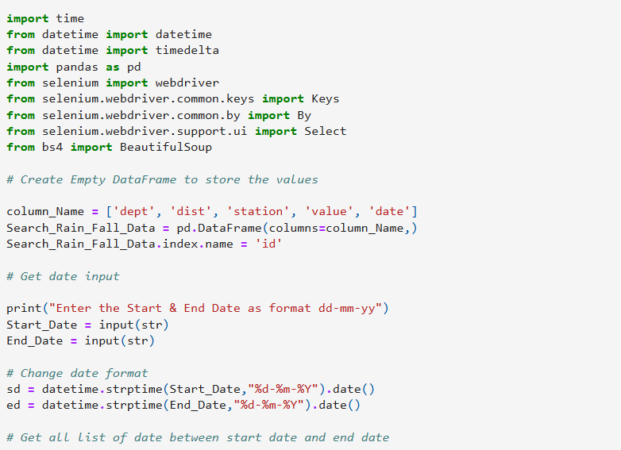
Data Extraction and Transformation
Code Snippet Example
Data Parsing with BeautifulSoup
Extracts tabular data from HTML.
Handles cases where no rainfall data is available:
Inserts 0 rainfall for those dates.
Data Cleaning
Converts columns to numeric types.
Structures data into a pandas DataFrame.

Slide 6

Results and Performance
Before Automation: Hours to take per year of data.
After Automation: Data retrieval is fully automated and hands-off, completing within 40-50 minutes for a year's worth of data, significantly improving efficiency.
Output: Data saved to a CSV for analysis.
Benefits and Takeaway
Efficiency: Time-saving for large datasets.
Accuracy: Reduces manual errors.
Scalability: Easily extendable to multiple date ranges.

Slide 7
Thank You!
Conclusion
Automation transforms repetitive tasks into streamlined workflows.
This project demonstrates the power of Python, Selenium, and BeautifulSoup.

